Slide 1
ANLP: Semantic Parsing
Bo Pang
10/02/2018

Slide 2
Outline
General Concept
Earlier work
Paper#1: Data Recombination for Neural Semantic Parsing
Paper#2: Greedy, Joint Syntactic-Semantic Parsing with Stack LSTMs
Paper#3: Coarse-to-Fine Decoding for Neural Semantic Parsing

Slide 3
Introduction
Converting natural language to a logical form
e.g., executable code for a specific application
Input
Javier likes pizza
Output
like(Javier, pizza)

Slide 4
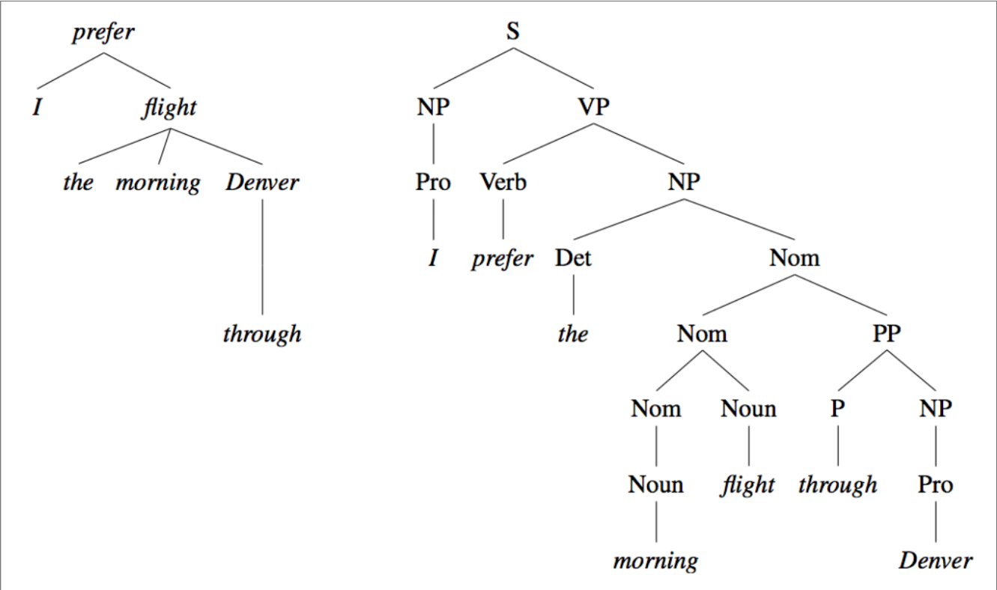
Syntactic Parser
Dependency and Phrase Based Parsing
A phrase structure representation may be found more suitable for languages with rather fixed word order patterns and clear constituency structures. Dependency representations, in contrast, may be found more adequate for languages which allow greater freedom of word order
Dependency Phrase
Speech and Language Processing, Jurafsky/Martin https://web.stanford.edu/~jurafsky/slp3/ed3book.pdf

Slide 5
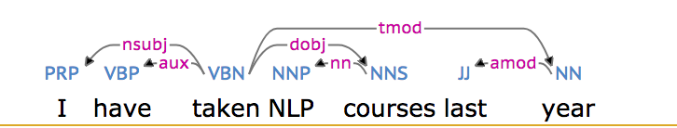
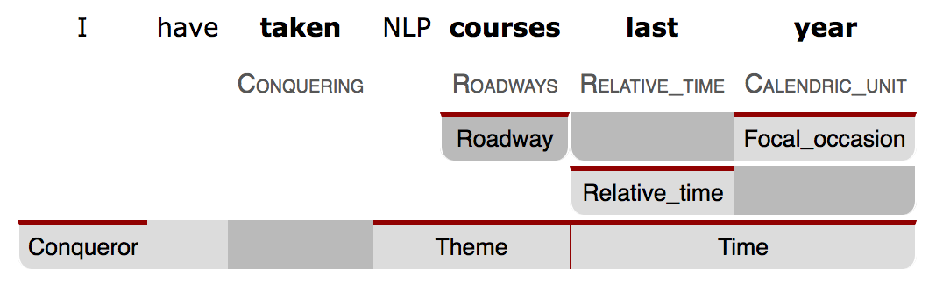
Syntactic Dependency Parse from TurboParser
Frame-Semantic Parse from SEMAFOR
ARK Syntactic & Semantic Parsing Demo

Slide 6
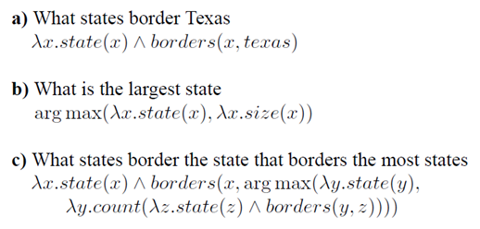
Sentence to Logical Form (Lambda Calculus)
-Zettlemoyer and Collins (2005)
A formal system in mathematical logic for expressing computation based on function abstraction and application using variable binding and substitution.
Lambda expressions represent functions. For example, ƛx.borders(x, texas) is a function from entities to truth values, which is true of those states that border Texas.
Notes:
conjunction

Slide 7
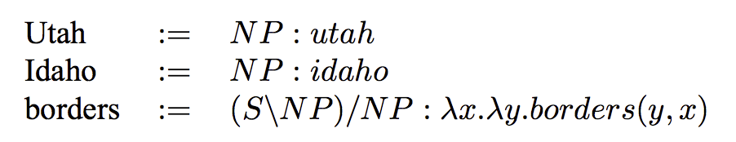
Combinatory Categorial Grammar (CCG)
Lexicon
Notes:
a category of the form A/B denotes a string that is of type A but is missing a string of type B to its right; similarly, A\B denotes a string of type A that is missing a string of type B to its left.

Slide 8
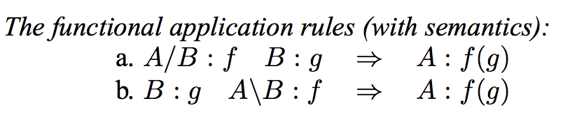
Combinatory Rules
which describe how adjacent categories in a string can be recursively combined
Notes:
The first rule says that a string with type A/B can be combined with a right-adjacent string of type B to form a new string of type A.

Slide 9
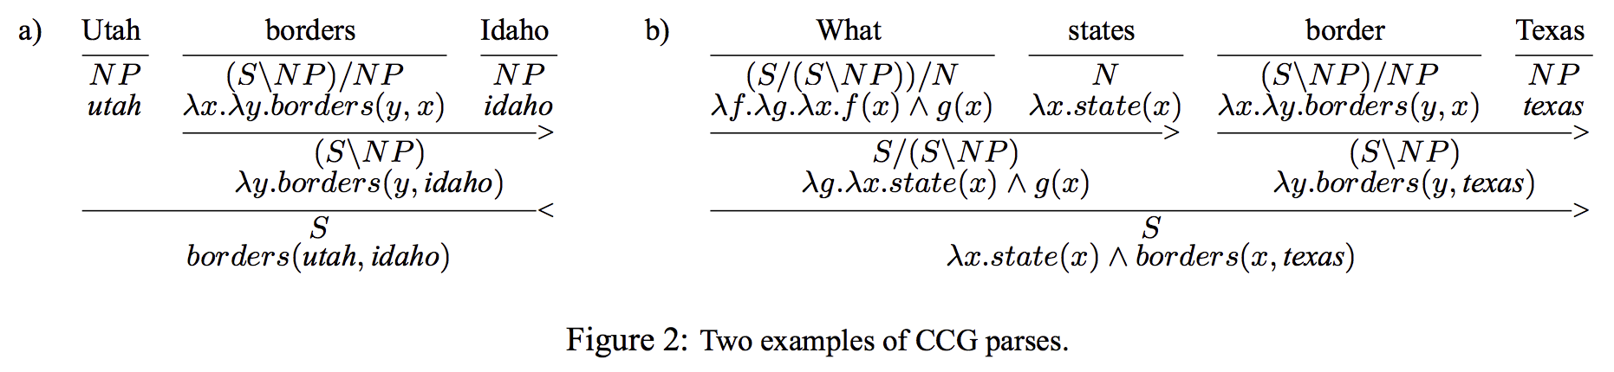

Slide 10
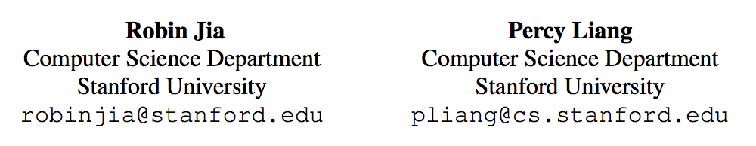
Data Recombination for Neural Semantic Parsing

Slide 11
Motivation
RNNs have had much success recently
Few domain specific assumptions allows them to be generally good without much feature engineering
Good Semantic Parsers rely on prior knowledge
How do we add prior knowledge to an RNN model?

Slide 12
Datasets
GeoQuery (GEO)
Natural language questions about US geography paired with corresponding Prolog database queries.
ATIS (ATS)
Natural language queries for a flights database paired with corresponding database queries written in lambda calculus
Overnight (OVERNIGHT)
Logical forms paired with natural language paraphrases across eight varied subdomains

Slide 13
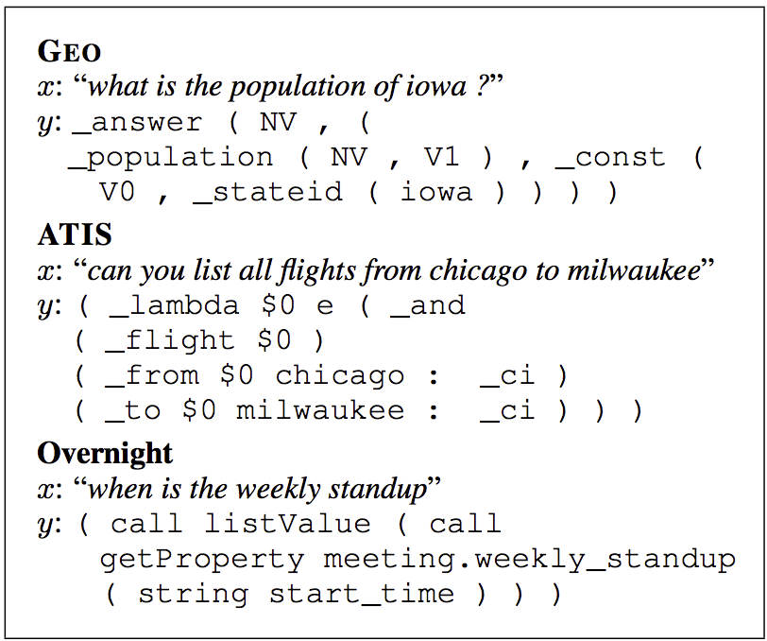

Slide 14

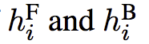
Seq2Seq RNN Model
Encoder:
Input sequence x1,...,xm → context sensitive embeddings b1,...,bm using a bidirectional RNN
For each input position i, we define the context-sensitive embedding bi to be the concatenation of

Slide 15
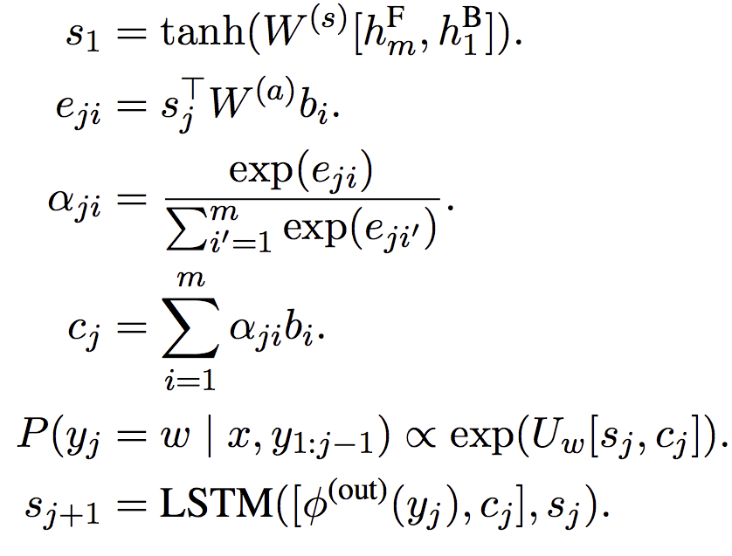
Decoder:
Generates the output sequence y1,...,yn one token at a time.

Slide 16
Attention mechanism
Intuition based on visual attention found in humans. Essentially come down to being able to focus on a certain region of an image with “high resolution” while perceiving the surrounding image in “low resolution”.
we let the model learn what to attend to based on the input sentence and what it has produced so far.
Attention and Memory in Deep Learning and NLP

Slide 17
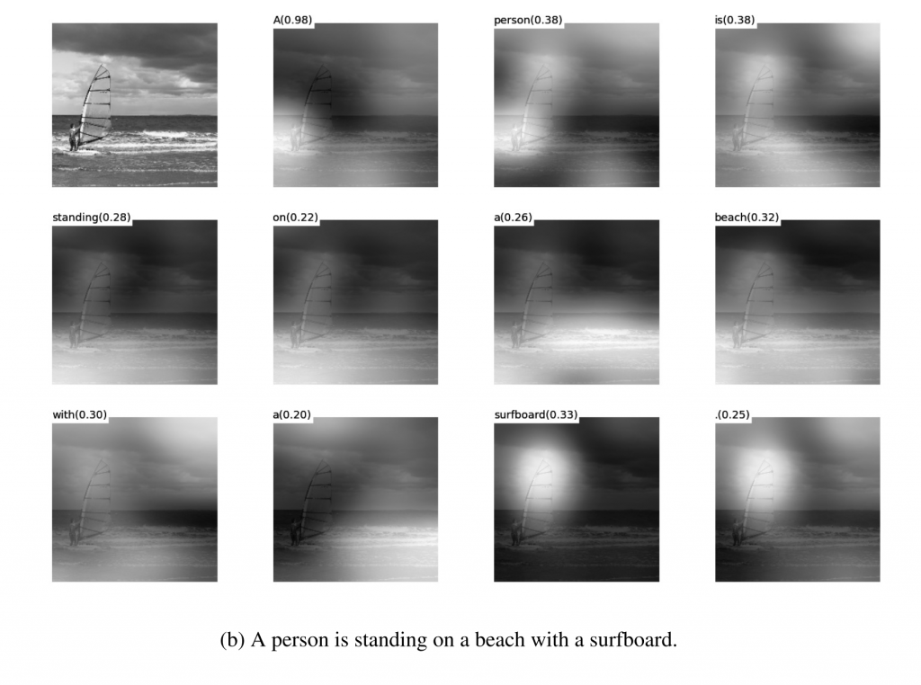
Show, attend and tell

Slide 18
Attention-based copying
This model has difficulty generalizing to the long tail of entity names commonly found in semantic parsing datasets. Entity names in the input often correspond directly to tokens in the output. E.g. “iowa” becomes iowa.

Slide 19
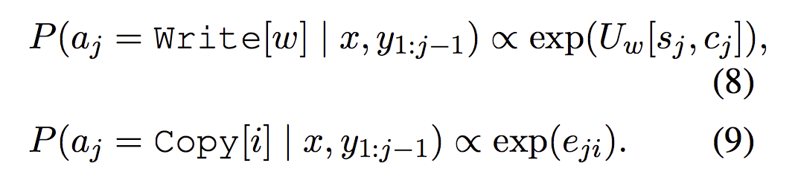
Attention-based copying
At each time step j, the decoder generates one of two types of actions: write or copy.
Notes:
The decoder chooses aj with a softmax over all these possible actions; yj is then a deterministic function of aj and x

Slide 20
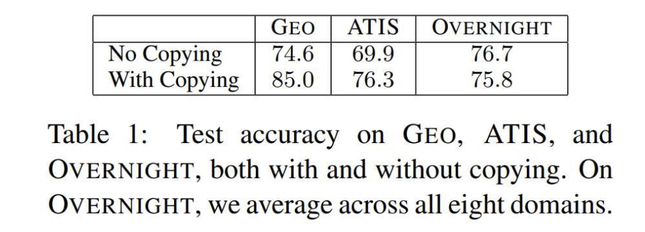

Slide 21
Data Recombination
Motivation
General setting
SCFG

Slide 22
Motivation
Induce a high-precision generative model from the training data
Sample from it to generate new training examples
Data augmentation focus on modeling invariances - transformations like translating an image or adding noise that alter the inputs x, but do not change the output y.
What they want: instead of holding y fixed, they would like to apply simultaneous transformations to x and y such that the new x still maps to the new y.
Data Recombination for Neural Semantic Parsing

Slide 23
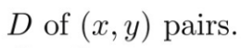
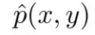
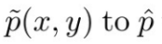
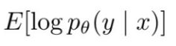
General Setting
Start with training set
is the empirical distribution
Fit a generative model which generalizes beyond with recombinant examples
To train model, maximize
Notes:
In the general setting of data recombination, we start with a training set D of (x, y) pairs, which defines the empirical distribution pˆ(x, y). We then fit a generative model p˜(x, y) to pˆ which generalizes beyond the support of pˆ, for example by splicing together fragments of different examples.

Slide 24
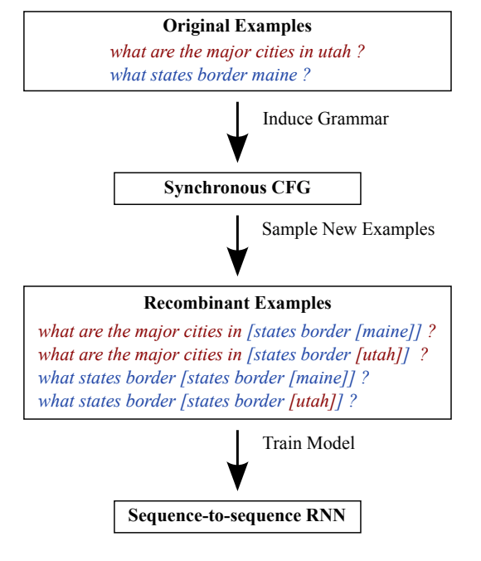
Synchronous context-free grammar (SCFG)

Slide 25
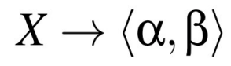
Synchronous Context-free Grammar
Consist of a set of production rules
Where X is a category (non-terminal), and a and b are sequences of terminal and non-terminal symbols.
Any non-terminal symbols in α must be aligned to the same non-terminal symbol in β, and vice versa. Therefore, an SCFG defines a set of joint derivations of aligned pairs of strings.
Data Recombination for Neural Semantic Parsing

Slide 26
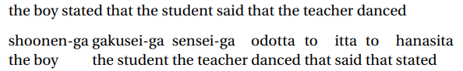
Motivation behind SCFG
We used finite transducers to perform many kinds of string transformations, but there are many kinds of transformations that they can’t perform. Even something as simple as reversing the input string is beyond the power of finite transducers.
David Chiang CSE 40/60657: Natural Language Processing

Slide 27
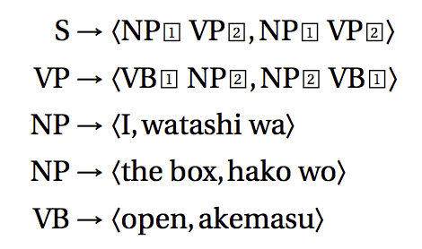
The boxed numbers i link up nonterminal symbols in the input rhs with nonterminal symbols in the output rhs: 1 links to 1 , 2 with 2 , and so on.
David Chiang CSE 40/60657: Natural Language Processing

Slide 28
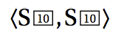
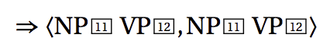
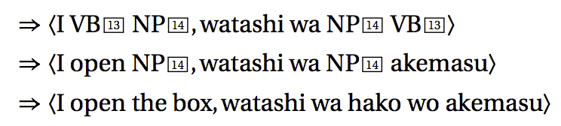
David Chiang CSE 40/60657: Natural Language Processing
Notes:
How does this grammar work? Just as we start in a CFG with a start symbol and repeatedly rewrite nonterminal symbols using the productions, so in a synchronous CFG, we start with a pair of linked start symbols

Slide 29
Grammar Induction Strategies
Abstracting Entities
Abstracts entities with their types
Abstracting Whole Phrases
Abstracts both entities and whole phrases with their types
Concatenation
For any k >=2, CONCAT-K creates two types of rules
ROOT going to a sequence of k SENT’s
• Then for each ROOT -> <α,β> in the input grammar, add rule SENT- > <α,β> to the output grammar
Composition of multiple Strategies

Slide 30
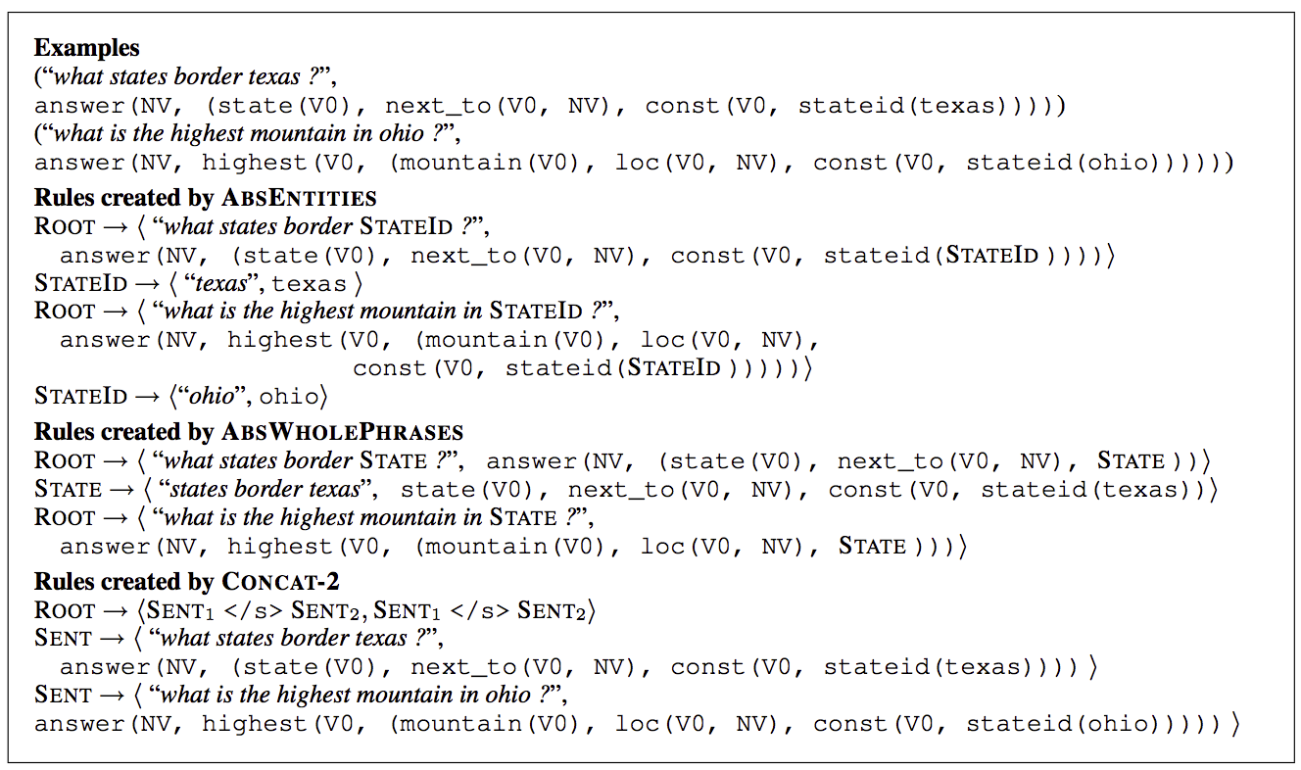

Slide 31
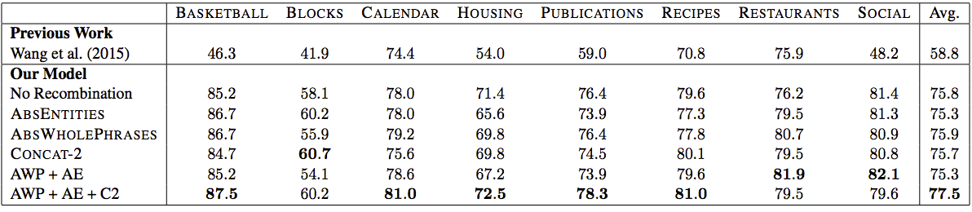

Slide 32
Conclusion
In data recombination, data generated by a high precision generative model is used to train a second, domain-general model.
Some of their induced grammars generate examples that are not in the test distribution, but nonetheless aid in generalization.
“Language is a blend of crisp regularities and soft relationships. Their work takes RNNs, which excel at modeling soft phenomena, and uses a highly structured tool—synchronous context free grammars—to infuse them with an understanding of crisp structure. They believe this paradigm for simultaneously modeling the soft and hard aspects of language should have broader applicability beyond semantic parsing.”
Data Recombination for Neural Semantic Parsing

Slide 33
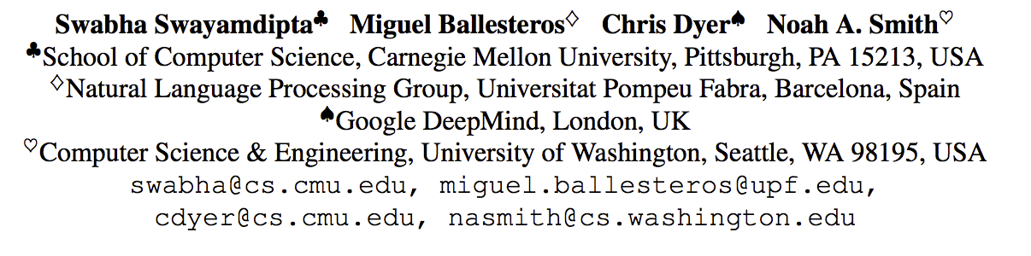
Greedy, Joint Syntactic-Semantic Parsing with Stack LSTMs
Notes:
learns a representation of the entire algorithm state, using stack long short-term memories.
First, it learns representations for the parser’s entire algorithmic state, not just the top items on the stack or the most recent parser states
Second, it uses entirely greedy inference rather than beam search.
Joint models like ours have frequently been proposed as a way to avoid cascading errors in NLP pipelines; varying degrees of success have been attained for a range of joint syntactic-semantic analysis tasks

Slide 34
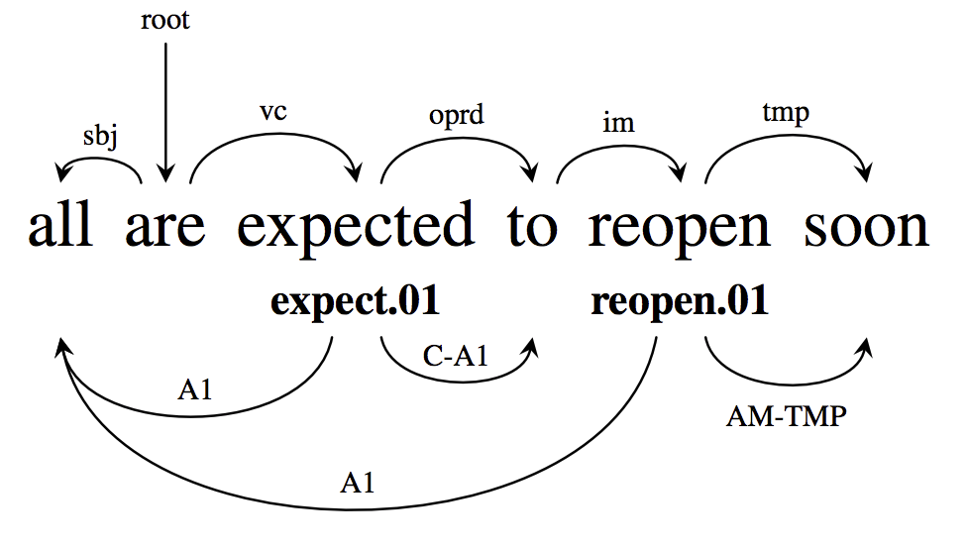
Joint Syntactic and Semantic Dependency Parsing

Slide 35
Transition-Based Procedure
Incrementally processing words in the sentence from left to right
Three stack data structures, where t is the timestep
Syntactic stack S_{t}
Semantic stack M_{t}
Buffer of input words B_{t}

Slide 36
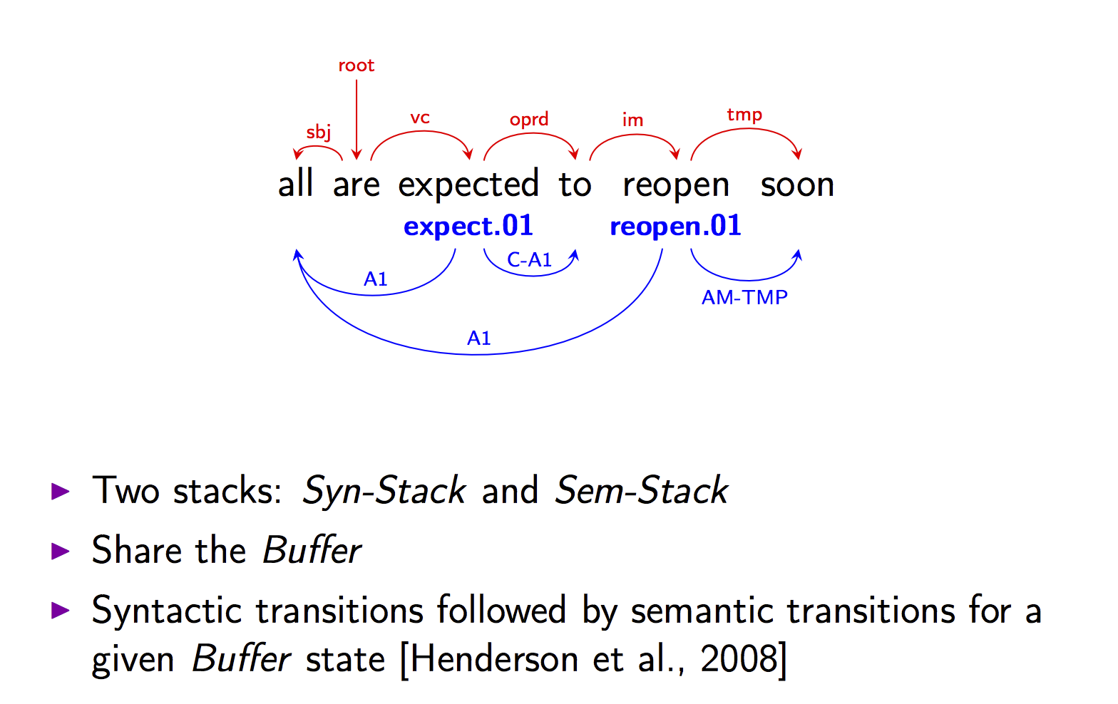
https://www.cs.cmu.edu/~sswayamd/talks/conll16.pdf

Slide 37
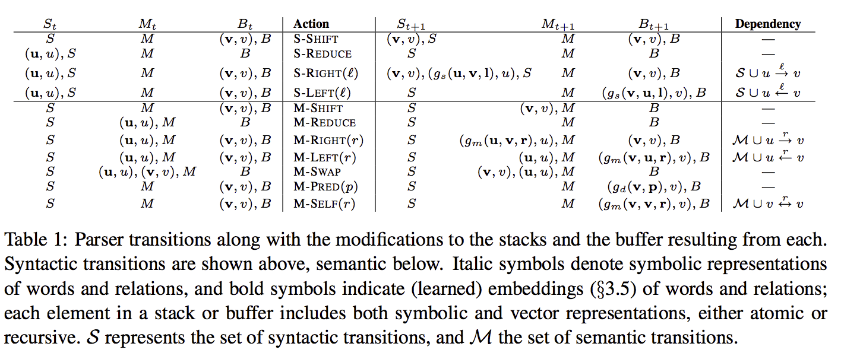
Transitions for Joint Parsing

Slide 38
The next slides are from Swayamdipta’s talk
https://www.cs.cmu.edu/~sswayamd/talks/conll16.pdf

Slide 39
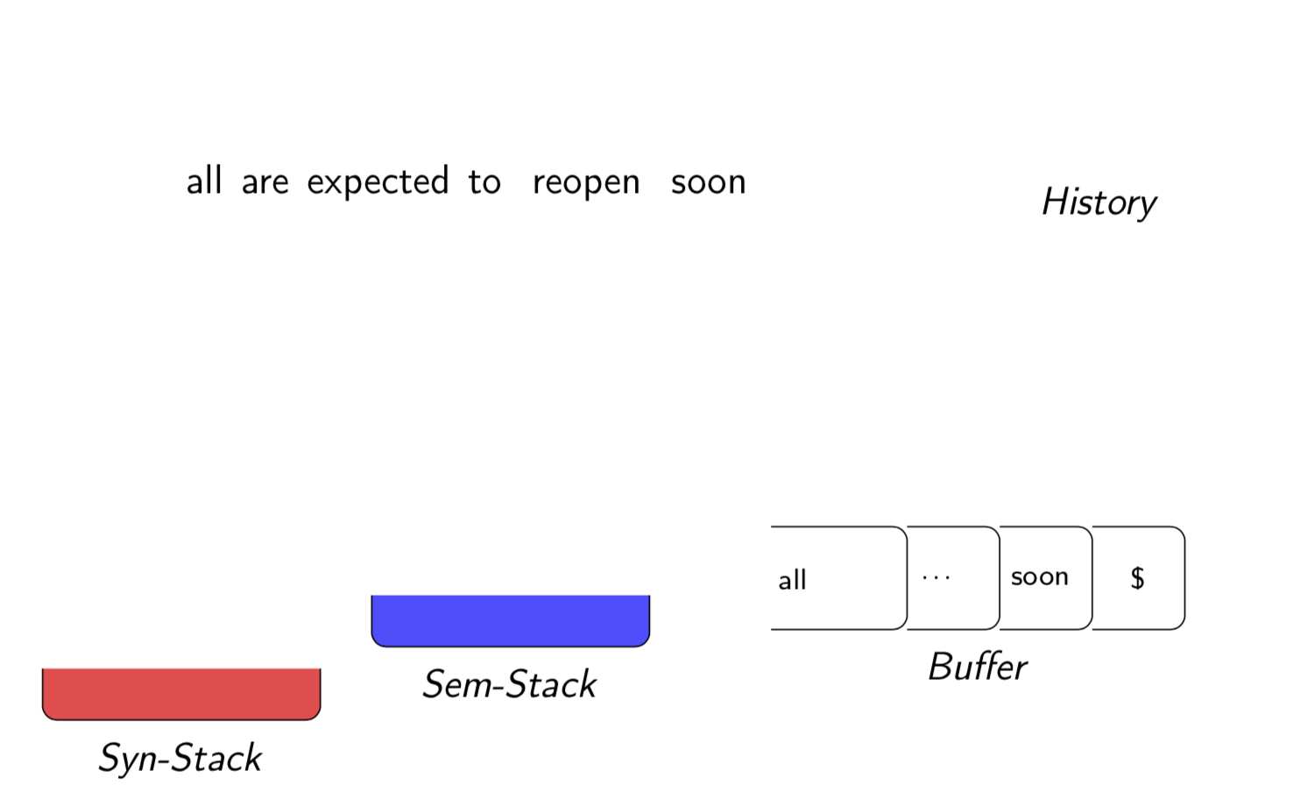

Slide 40
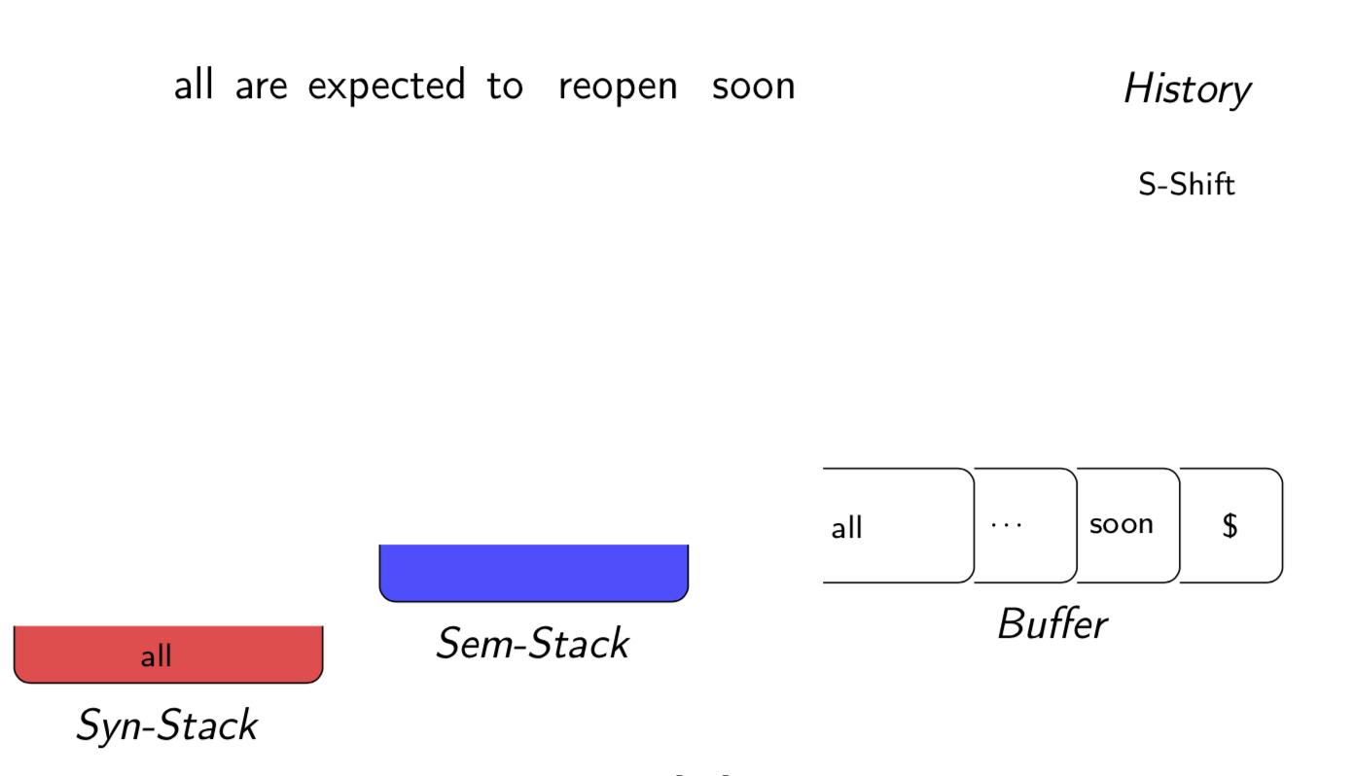

Slide 41
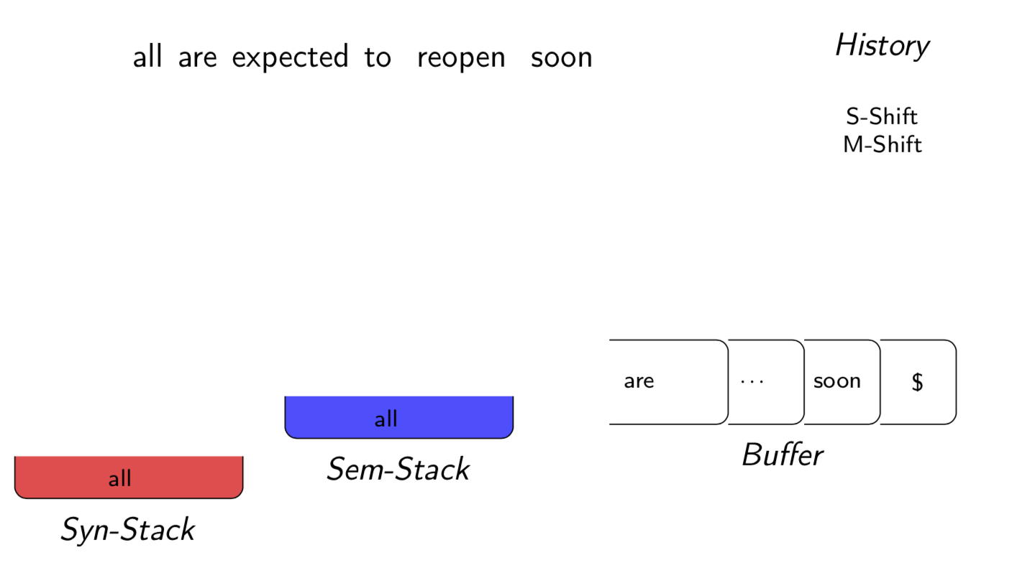

Slide 42
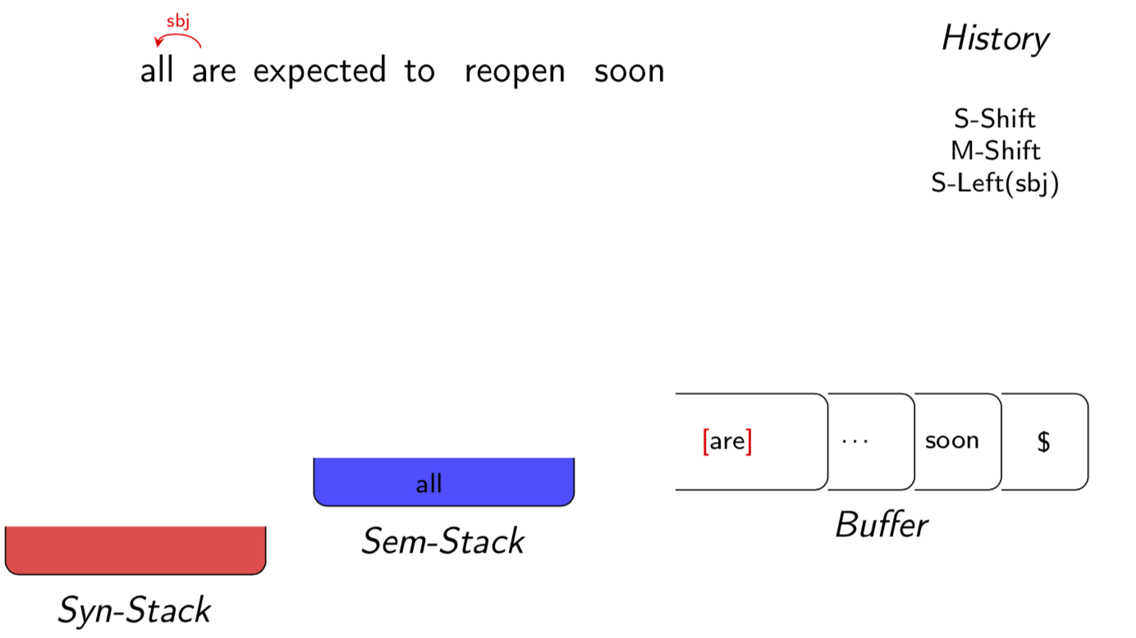

Slide 43
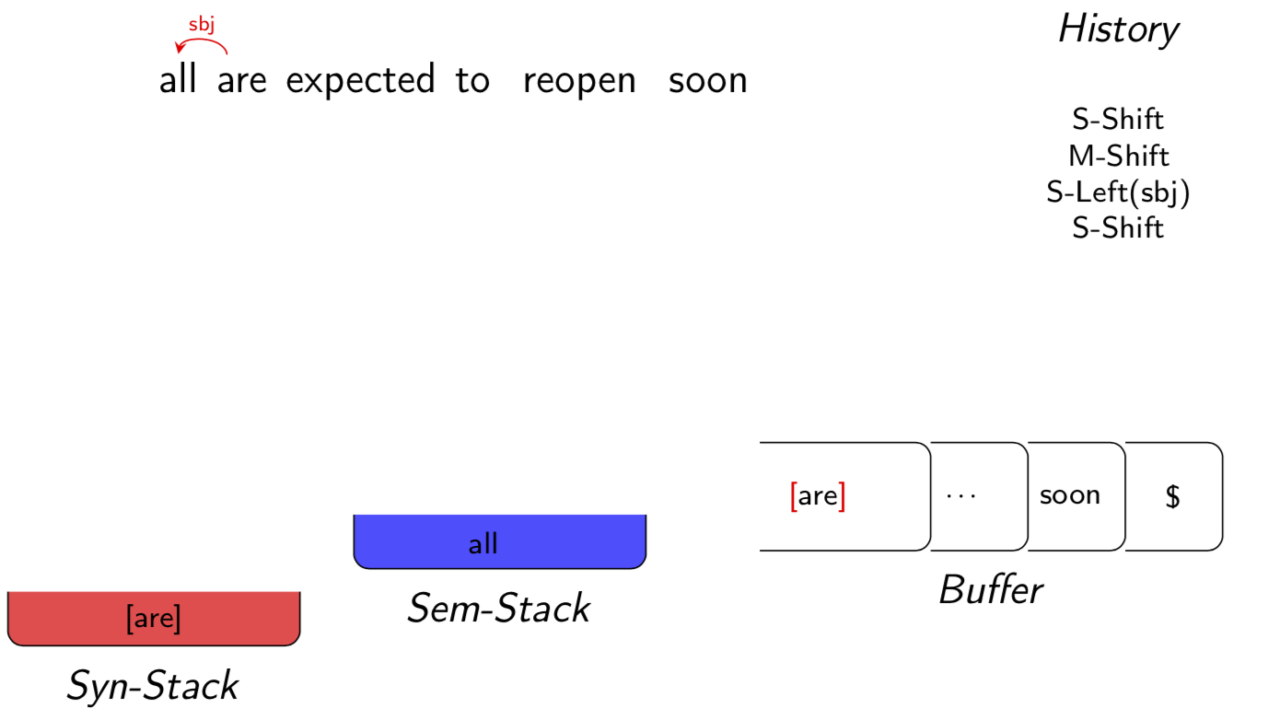

Slide 44
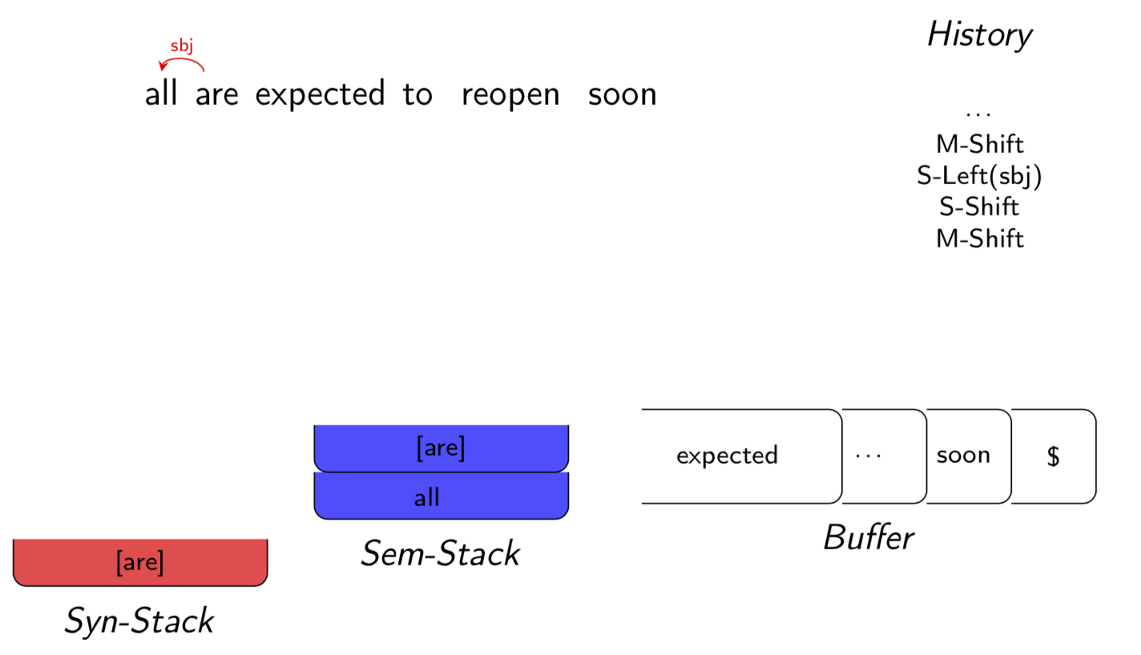

Slide 45
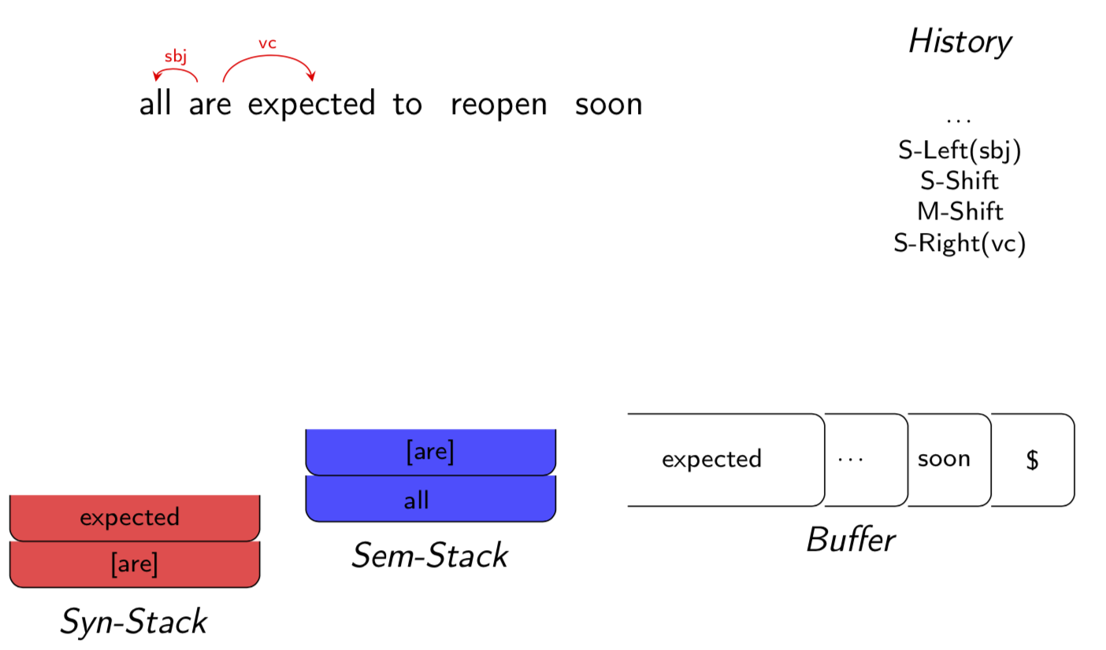

Slide 46
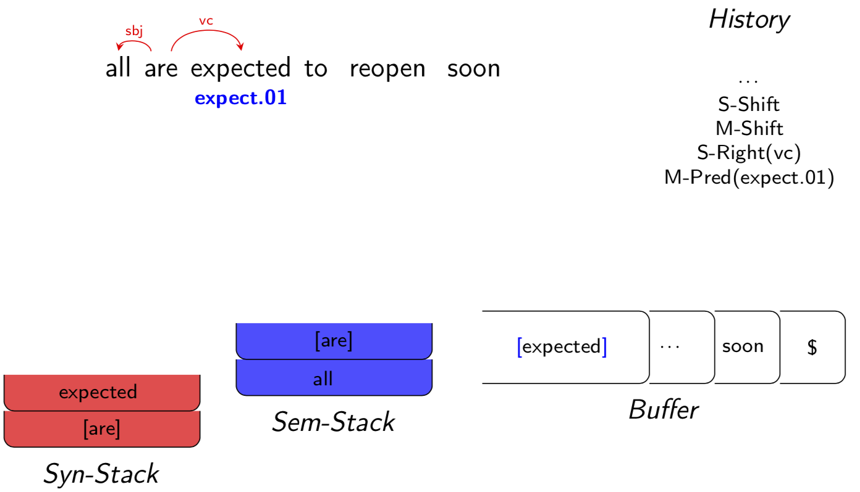
Notes:
marks the item at the front of B as a semantic predicate with the sense

Slide 47
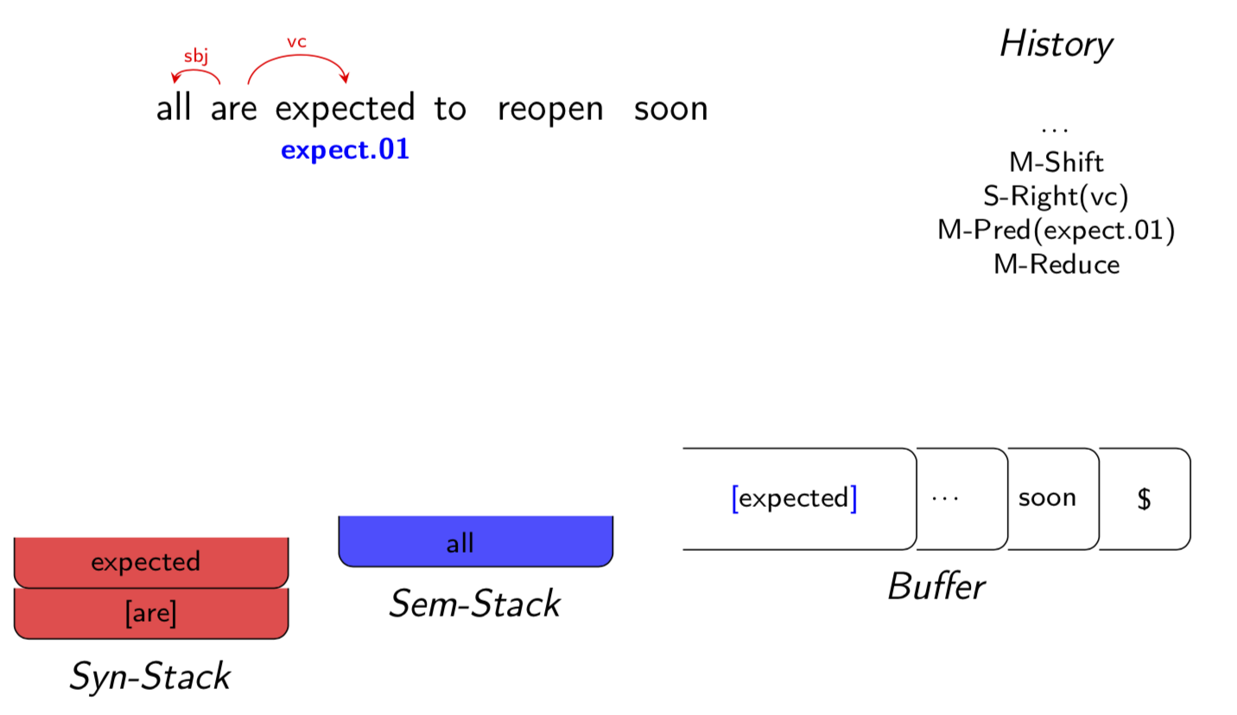

Slide 48
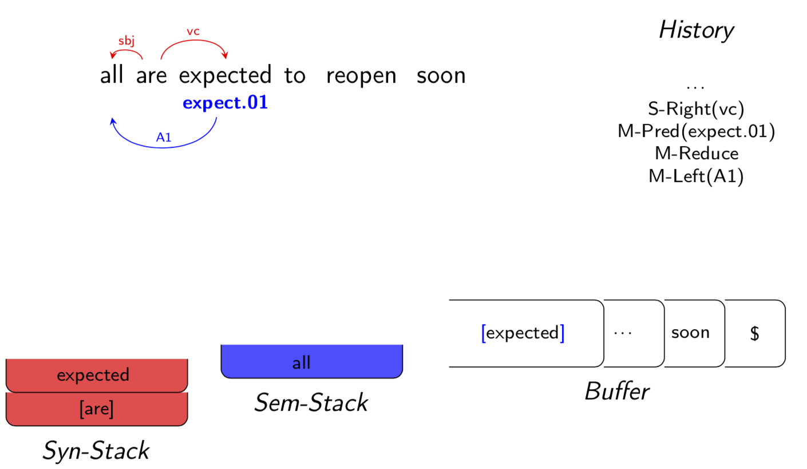

Slide 49
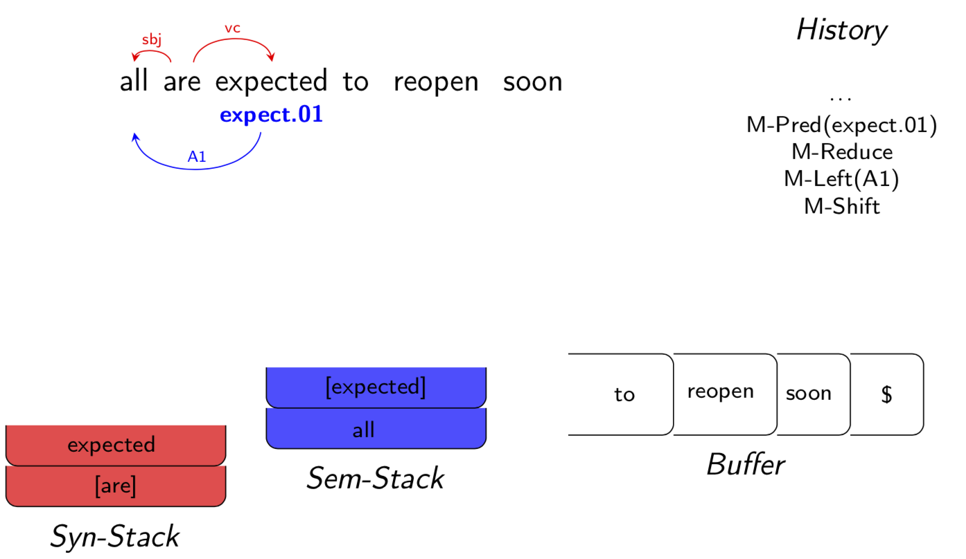

Slide 50
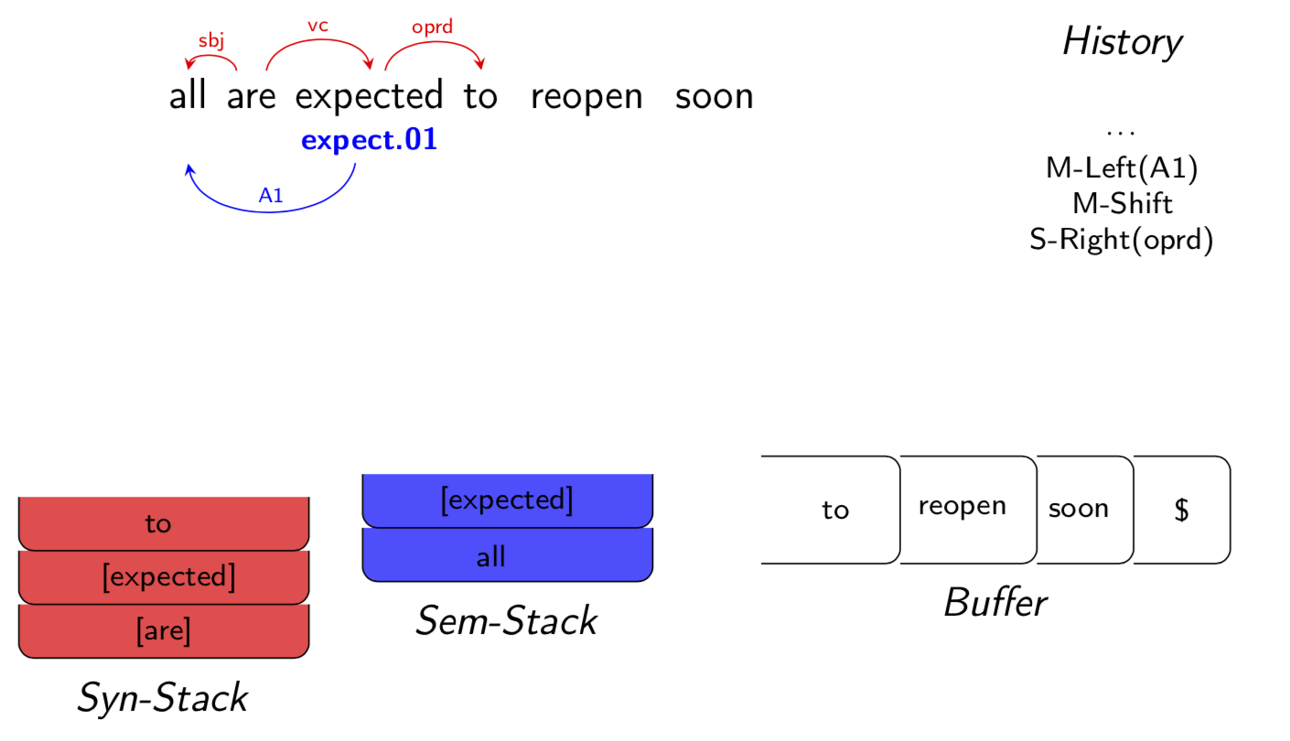

Slide 51
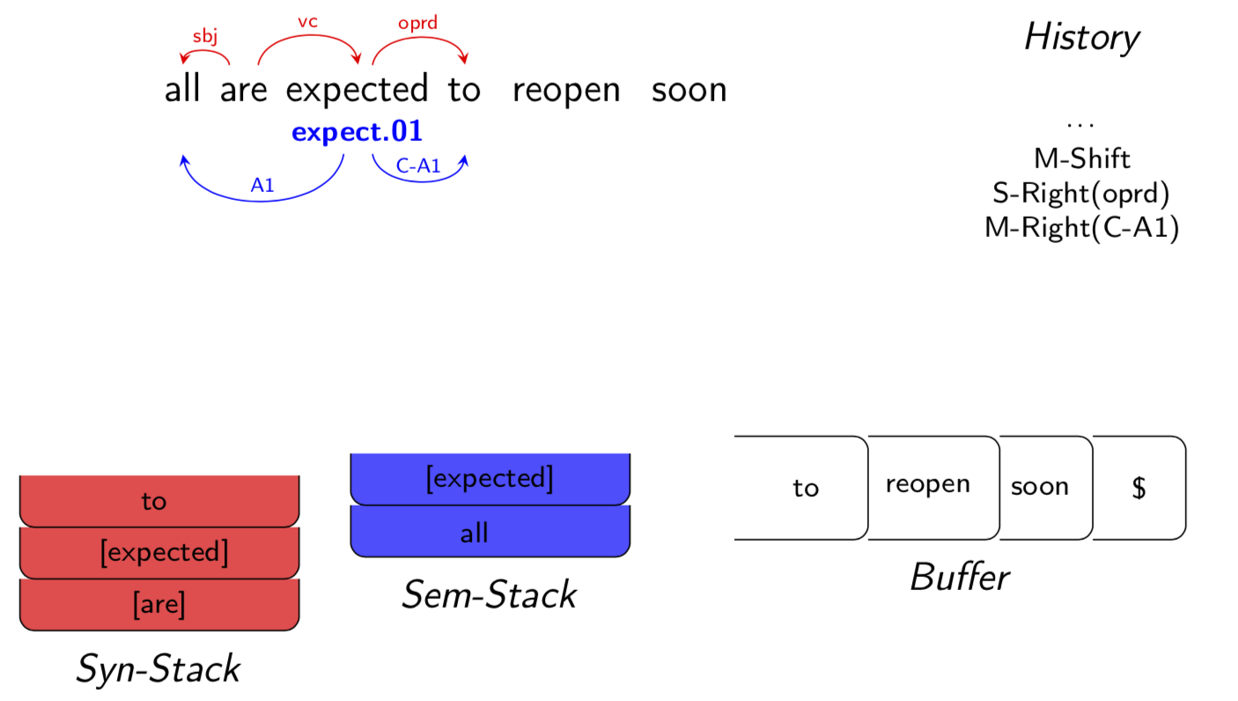

Slide 52
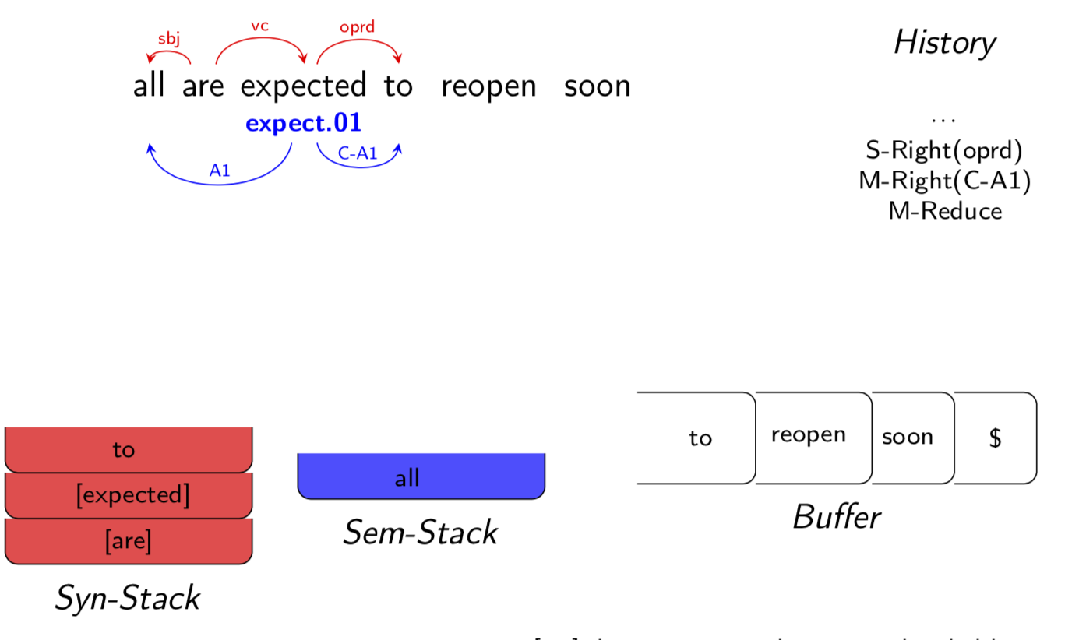

Slide 53


Slide 54
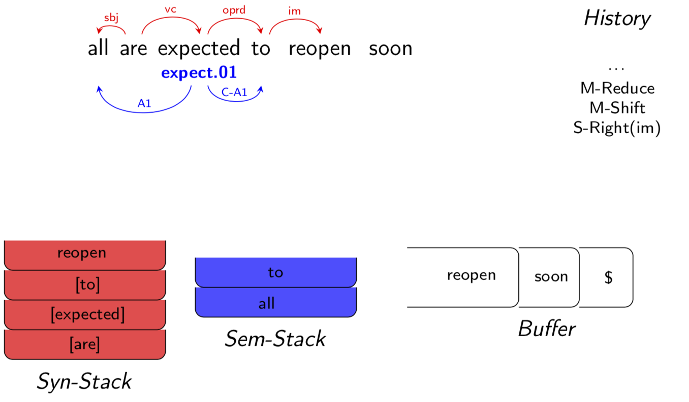

Slide 55
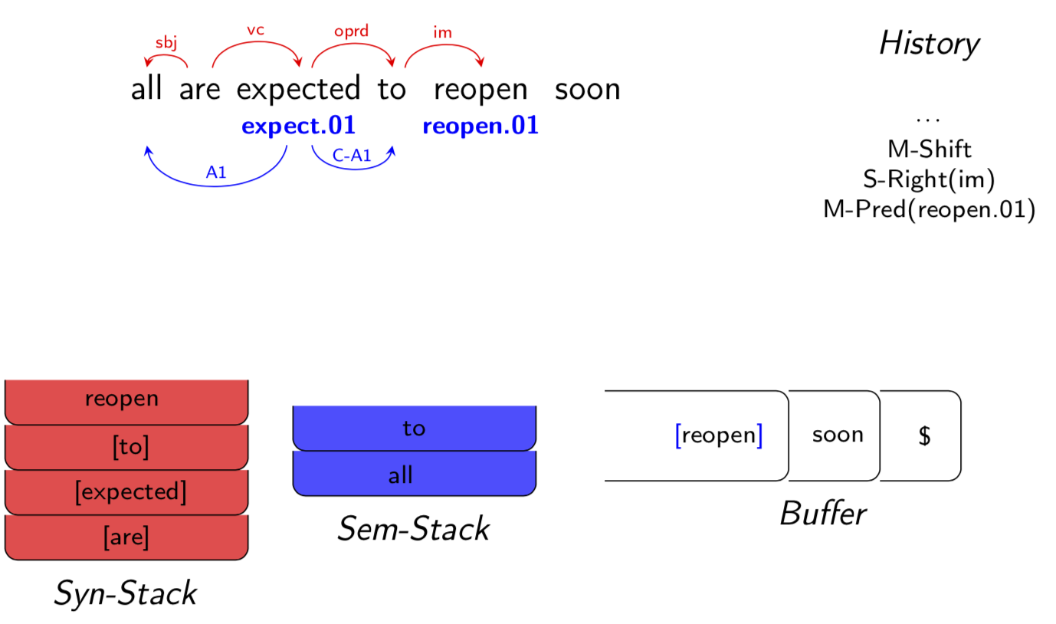

Slide 56
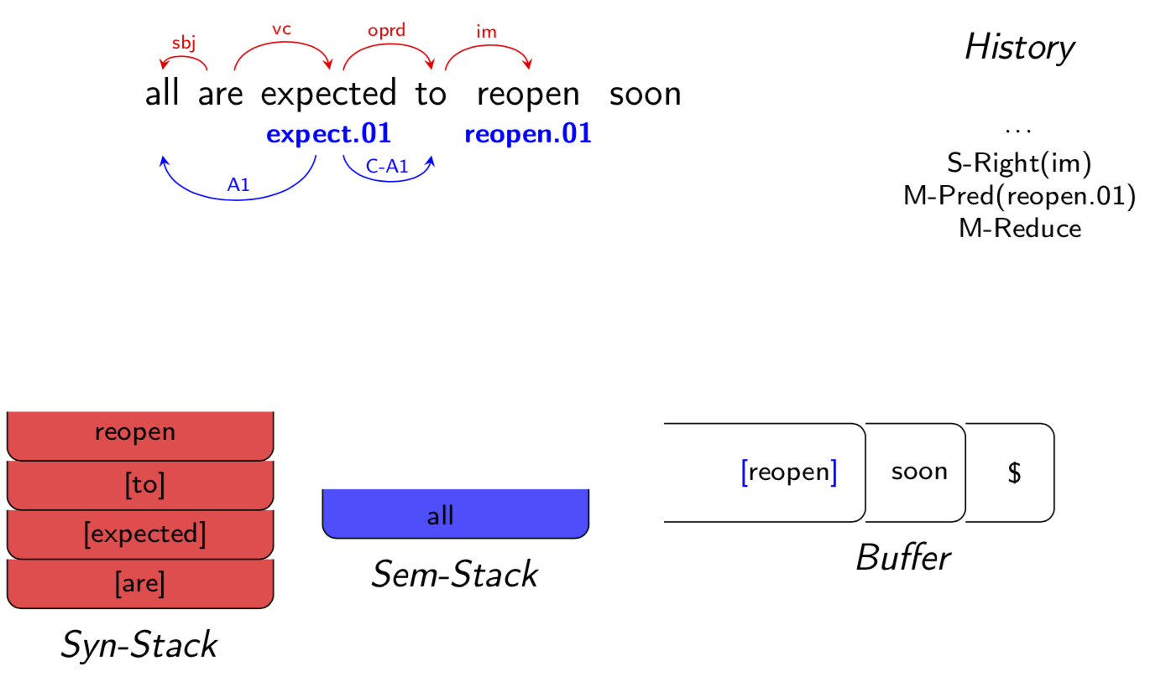

Slide 57
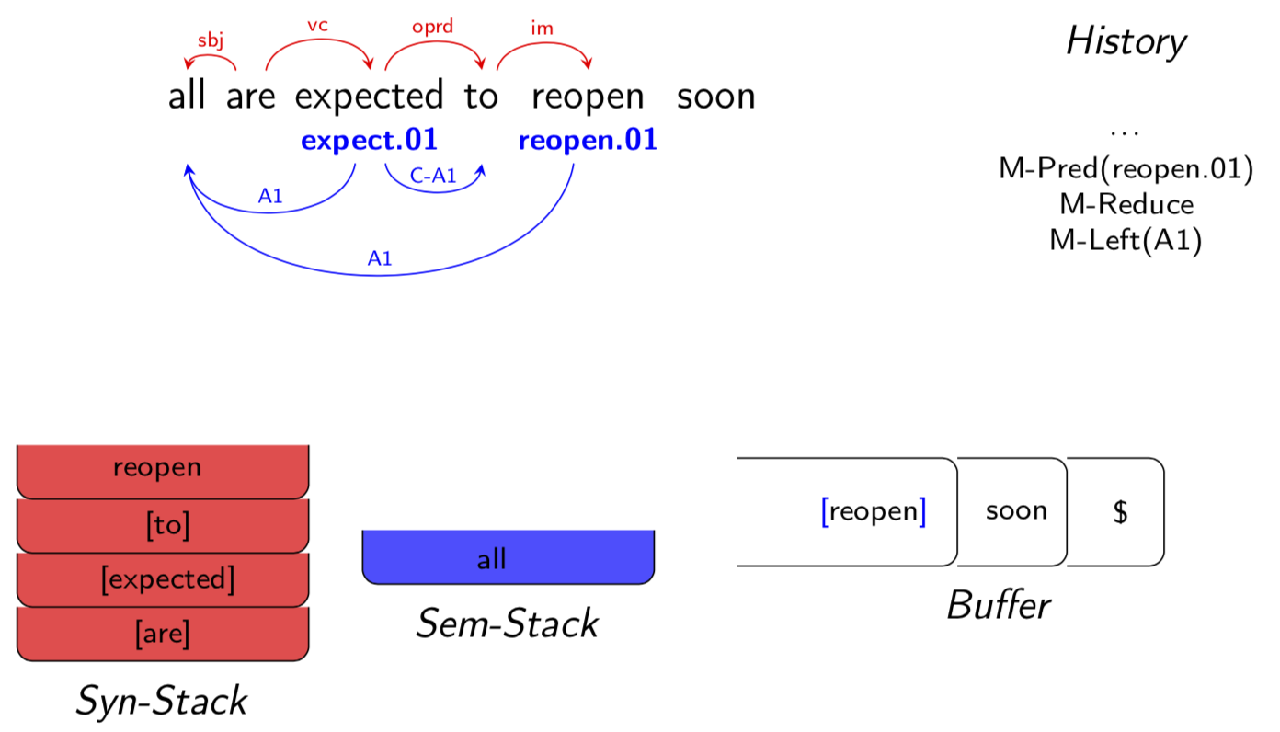

Slide 58
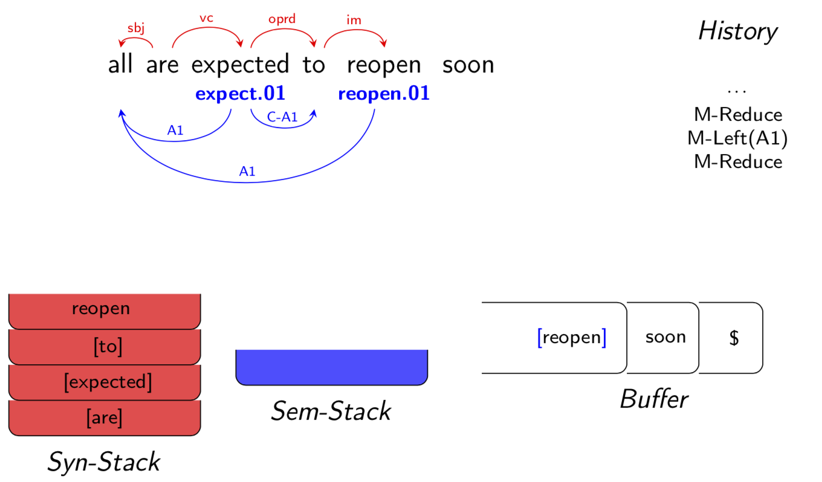

Slide 59


Slide 60


Slide 61


Slide 62


Slide 63


Slide 64


Slide 65


Slide 66
Stack LSTM
LSTM that is equipped with stack operations
A “stack pointer” is maintained which determines which cell in the LSTM provides the memory and hidden units when computing the new memory cell contents.
query → provides a summary of the stack in a single fixed-length vector
push → add an element to the top of the stack
pop → moves the stack pointer to the preceding timestep, resulting in a stack summary as it was before the popped item was observed
Greedy, Joint Syntactic-Semantic Parsing with Stack LSTMs
Notes:
Using stack LSTMs, we construct a representation of the algorithm state by decomposing it into smaller pieces that are combined by recursive function evaluations (similar to the way a list is built by a concatenate operation that operates on a list and an element). This enables information that would be distant from the “top” of the stack to be carried forward, potentially helping the learner.

Slide 67

Four stack LSTMs, one each for the S, M, and B data structures.
A fourth stack LSTM, A, for the history of actions.
The algorithm’s state at timestep t is encoded by the four vectors summarizing the four stack LSTMs, and this is the input to the classifier that chooses among the allowable transitions at that timestep

Slide 68
Experiment
Dataset: CoNLL 2008 & 2009
POS tags were used, but no other provided features
No manually-designed features
Dataset-specific hyperparameter tuning

Slide 69

Notes:
Several other joint learning models have been proposed (Llu´ıs and Marquez, 2008; Jo- ` hansson, 2009; Titov et al., 2009) for the same task; our joint model surpasses the performance of all these models.
We fall behind only Johansson and Nugues (2008), whose success was attributed to carefully designed global SRL features integrated into a pipeline of classifiers, making them asymptotically slower.

Slide 70
Conclusion
Incremental algorithm (linear) + model using stack LSTMs
Avoid the effort involved in manual feature engineering
Light-weight alternative to expensive pipelined systems
https://www.cs.cmu.edu/~sswayamd/talks/conll16.pdf

Slide 71

Coarse-to-Fine Decoding for Neural Semantic Parsing
Notes:
They propose to decompose the decoding process into two stages. The first decoder focuses on predicting a rough sketch of the meaning representation, which omits low-level details, such as arguments and variable names. Example sketches for various meaning representations are shown in Table 1. Then, a second decoder fills in missing details by conditioning on the natural language input and the sketch itself.

Slide 72


Slide 73

Problem Formulation
Let x = x₁ ··· x_{|x|} denote a natural language expression, and y = y₁ ··· y_{|y|} its meaning representation
Notes:
Our goal is to learn semantic parsers from instances of natural language expressions paired with their structured meaning representations.
We wish to estimate p (y|x), the conditional probability of meaning representation y given input x. We decompose p (y|x) into a two stage generation process

Slide 74


Slide 75

Notes:
The generation probabilities are factorized as:

Slide 76

Sketch Generation
Input Encoder
Bi-directional LSTM

Slide 77




Coarse Meaning Decoder
With attention mechanism
Attention score:

Slide 78

Sketch Encoder
Notes:
As shown in Figure 1, a bidirectional LSTM encoder maps the sketch sequence a into vectors {vk} |a| k=1 as in Equation (6), where vk denotes the vector of the k-th time step.

Slide 79



Fine Meaning Decoder
LSTM with attention mechanism
Hidden states
y_{t−1} is the embedding of the previously predicted token

Slide 80

The sketch constraints the decoding output.
In some cases, sketch tokens will indicate what information is missing. flight@1 in sketch
Type information in sketches can be used to constrain generation. In Table 1, sketch token “NUMBER” specifies that a numeric token should be emitted
For the missing details, we use the hidden vector h_{t} to compute p (y_{t}|y<t, x, a), analogously to Equations (7)–(10) used in sketch generations.

Slide 81

The model’s training objective is to maximize the log likelihood of the generated meaning representations given natural language expressions

Slide 82
Natural Language to Source Code
DJANGO: a dataset built upon the Python code of the Django library. 16000 training, 1000 development, and 1805 test instances.
Tokenized the code using built-in lexical scanner of Python.
Handled out-of-vocabulary (OOV) tokens (e.g., variable names, and numbers) with a copying mechanism, which allows the fine meaning decoder to directly copy tokens from the input.

Slide 83

Copying Mechanism: Learnt a copying gate g_{t} ∈ [0, 1] to decide whether y_{t} should be copied from the input or generated from the vocabulary.

Slide 84


Notes:
Table2: disentangling high-level from low-level information during decoding is beneficial. The results also show that removing the sketch encoder harms performance since the decoder loses access to additional contextual information. As can be seen, predicting the sketch correctly boosts performance. Oracle sketch result is presented as an upper-bound.
Table3:COARSE2FINE outperforms ONESTAGE by a wide margin. It is also superior to the best reported result in the literature (SNM+COPY; see the second block in the table). Again we observe that the sketch encoder is beneficial and that there is an 8.9 point difference in accuracy between COARSE2FINE and the oracle.

Slide 85
Conclusion
Sketches
Abstract away from low-level information such as arguments and variable names
Predict missing details in order to obtain full meaning representations
Easily adapt to and improve performance across different domains and tasks.

Slide 86
Discussion
Can you think of other cases where sketches have importance?
What sentences are difficult to analysis into semantic forms?
How to deal with ambiguity?
How to deal with ungrammatical sentences?

Slide 87
References
David Chiang CSE 40/60657: Natural Language Processing Chapter 15
Data Recombination for Neural Semantic Parsing
Greedy, Joint Syntactic-Semantic Parsing with Stack LSTMs
Coarse-to-Fine Decoding for Neural Semantic Parsing
Learning to Map Sentences to Logical Form: Structured Classification with Probabilistic Categorial Grammars
ARK Syntactic & Semantic Parsing Demo
https://www.cs.cmu.edu/~sswayamd/talks/conll16.pdf
https://courses.engr.illinois.edu/cs546/sp2018/Slides/Mar08_Jia.pdf
Attention and Memory in Deep Learning and NLP

Slide 88


